Slide 1

Oceanography Merit Badge
Troop 344 and 9344
Pemberville, OH

Slide 2
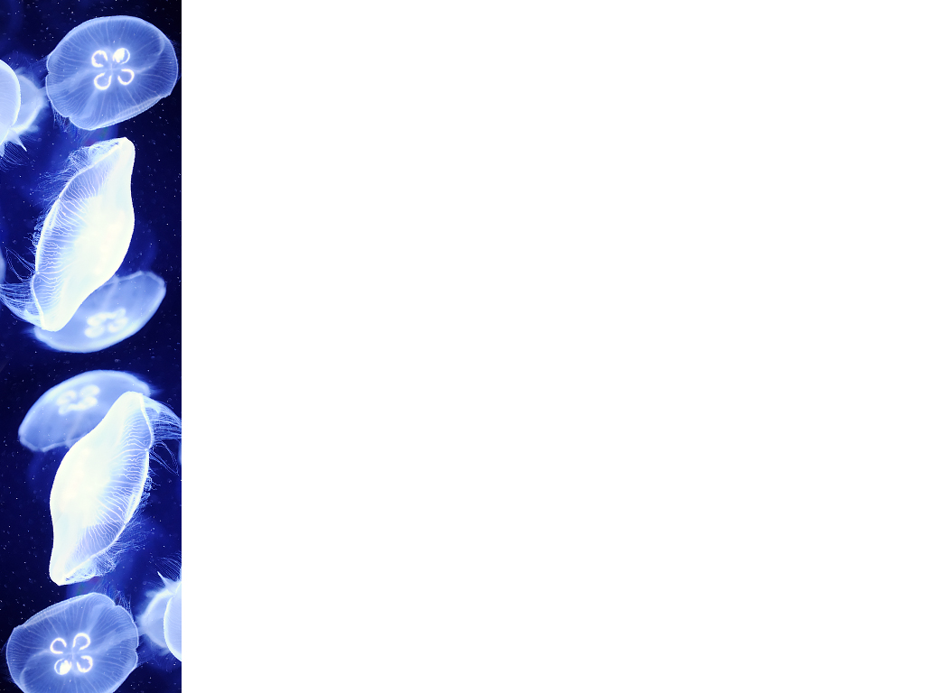
Oceanography Merit Badge Requirements
Name four branches of oceanography. Describe at least five reasons why it is important for people to learn about the oceans.
Define salinity, temperature, and density, and describe how these important properties of seawater are measured by the physical oceanographer. Discuss the circulation and currents of the ocean. Describe the effects of the oceans on weather and climate.
Describe the characteristics of ocean waves. Point out the differences among the storm surge, tsunami, tidal wave, and tidal bore. Explain the difference between sea, swell, and surf. Explain how breakers are formed.

Slide 3

Oceanography Merit Badge Requirements
Draw a cross-section of underwater topography. Show what is meant by:
  Continental shelf
  Continental slope, and
  Abyssal plain
Name and put on your drawing the following: seamount, guyot, rift valley, canyon, trench, and oceanic ridge. Compare the depths in the oceans with the heights of mountains on land.

Slide 4
Oceanography Merit Badge Requirements
List the main salts, gases, and nutrients in sea water. Describe some important properties of water. Tell how the animals and plants of the ocean affect the chemical composition of seawater. Explain how differences in evaporation and precipitation affect the salt content of the oceans.
Describe some of the biologically important properties of seawater. Define benthos, nekton, and plankton. Name some of the plants and animals that make up each of these groups. Describe the place and importance of phytoplankton in the oceanic food chain.

Slide 5
Oceanography Merit Badge Requirements
Do ONE of the following:
  Make a plankton net. Tow the net by a dock, wade with it, hold it in a current, or tow it from a rowboat. Do this for about 20 minutes. Save the sample. Examine it under a microscope or high-power glass. Identify the three most common types of plankton in the sample.
  Make a series of models (clay or plaster and wood) of a volcanic island. Show the growth of an atoll from a fringing reef through a barrier reef. Describe the Darwinian theory of coral reef formation.
  Measure the water temperature at the surface, midwater, and bottom of a body of water four times daily for five consecutive days. You may measure depth with a rock tied to a line. Make a Secchi disk to measure turbidity (how much suspended sedimentation is in the water). Measure the air temperature. Note the cloud cover and roughness of the water. Show your findings (air and water temperature, turbidity) on a graph. Tell how the water temperature changes with air temperature.
  Make a model showing the inshore sediment movement by littoral currents, tidal movement, and wave action. Include such formations as high and low waterlines, low tide terrace, berm, and coastal cliffs. Show how the offshore bars are built up and torn down.
  Make a wave generator. Show reflection and refraction of waves. Show how groins, jetties, and breakwaters affect these patterns.
  Track and monitor satellite images available on the Internet for a specific location for three weeks. Describe what you have learned to your counselor.

Slide 6
Oceanography Merit Badge Requirements
Do ONE of the following:
  Write a 500-word report on a book about oceanography approved by your counselor.
  Visit one of the following: (1) an oceanographic research ship, or (2) an oceanographic institute, marine laboratory, or marine aquarium. Write a 500-word report about your visit.
  Explain to your troop in a five minute prepared speech "Why Oceanography Is Important" or describe "Career Opportunities in Oceanography." (Before making your speech, show your speech outline to your counselor for approval.)
Describe four methods that marine scientists use to investigate the ocean, underlying geology, and organisms living in the water.

Slide 7
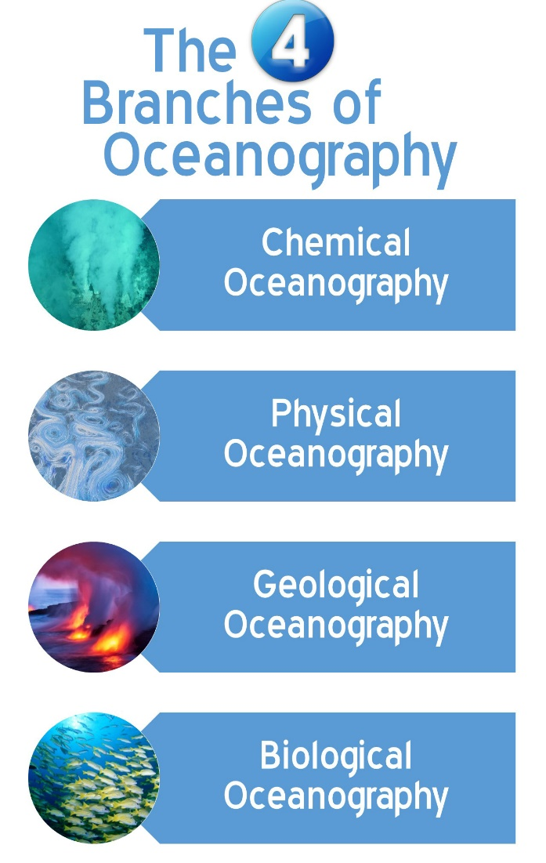
Requirement 1
Name four branches of oceanography. Describe at least five reasons why it is important for people to learn about the oceans.

Slide 8
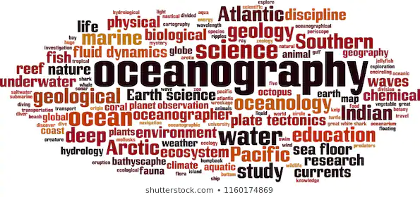
Oceanography
Oceanography is the scientific discipline concerned with all aspects of the world’s oceans and seas, including their physical and chemical properties, their origin and geologic framework, and the life forms that inhabit the marine environment.

Slide 9
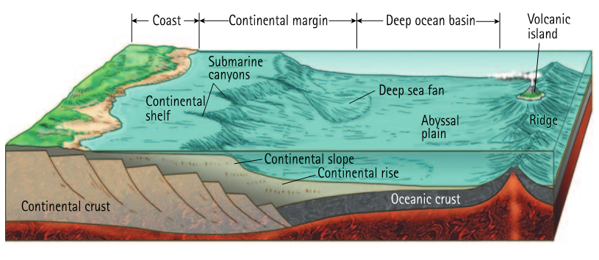
Geological Oceanography
Geological Oceanography focuses on the structure, features, and evolution of the ocean basins.

Slide 10
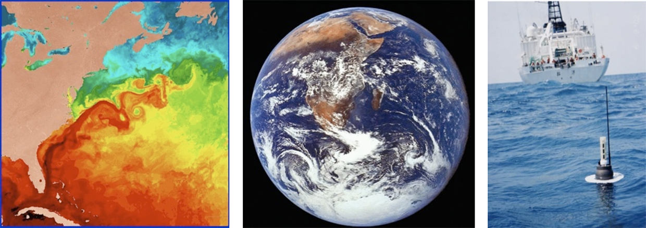
Physical Oceanography
Physical Oceanography involves the study of the properties (temperature, density, etc.) and movement (waves, currents, and tides) of seawater and the interaction between the ocean and the atmosphere.

Slide 11
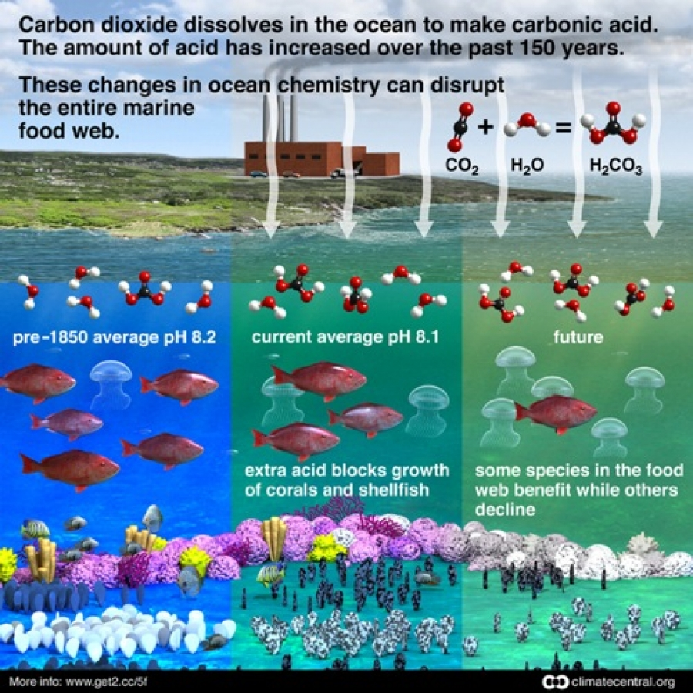
Chemical Oceanography
Chemical Oceanography involves the study of the composition of seawater and the biogeochemical cycles that affect it.

Slide 12
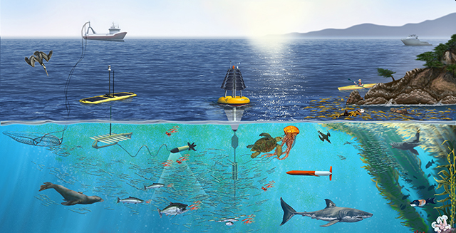
Biological Oceanography
Biological Oceanography involves the study of the biological organisms in the ocean (including life cycles and food production) such as bacteria, phytoplankton, zooplankton and extending to the more traditional marine biology focus of fish and marine mammals.

Slide 13
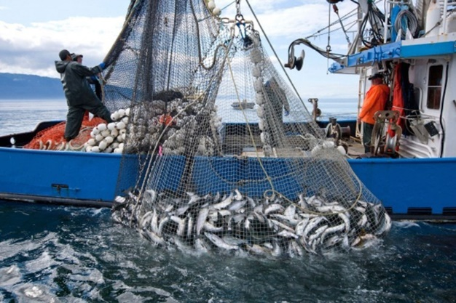
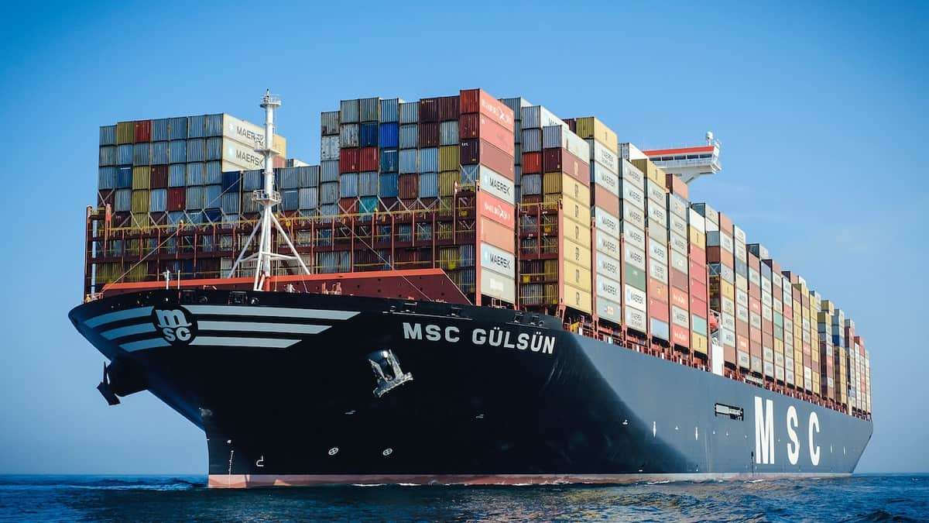
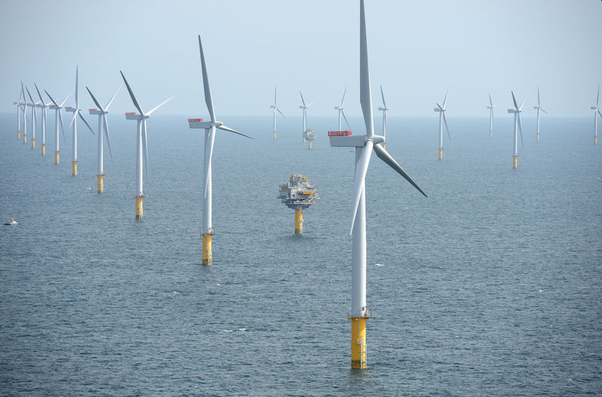
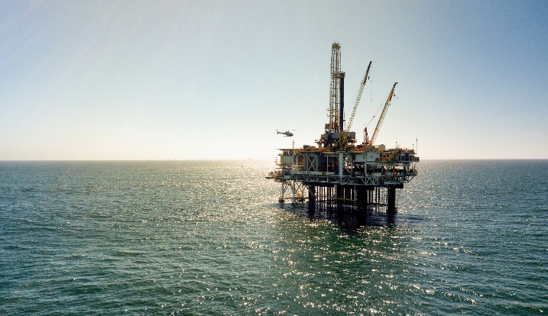
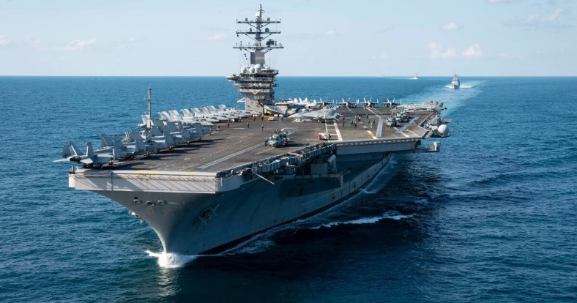
Importance of Oceanography
Oceanography is important to many of the world's concerns, including the following:
  Global climate change
  Source of food
  Source of minerals
  Commerce (movement of goods and people)
  Waste disposal
  Important medium of national defense
  Recreation
  Energy production

Slide 14
Requirement 2
Define salinity, temperature, and density, and describe how these important properties of seawater are measured by the physical oceanographer. Discuss the circulation and currents of the ocean. Describe the effects of the oceans on weather and climate.

Slide 15
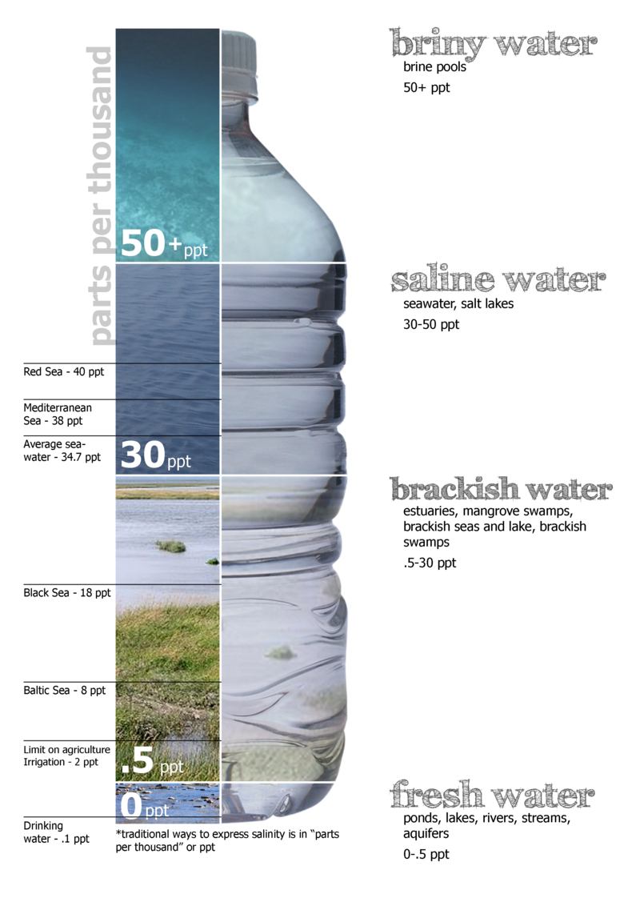
Ocean Salinity
Salinity is the saltiness or amount of salt dissolved in a body of water, called saline water.
On average, about 35 g of salt is present in each 1 kg of seawater, so we say that the average salinity of the ocean salinity is 35 parts per thousand (ppt).
Salinity is an important factor in determining many aspects of the chemistry of ocean waters and of biological processes within it.

Slide 16
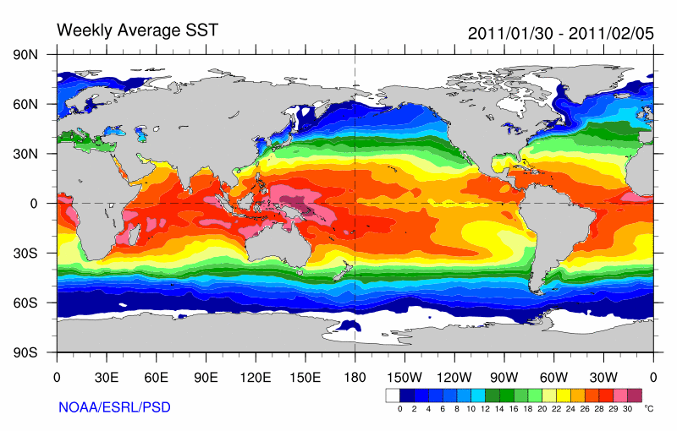
Ocean Temperature
Temperature is a physical quantity that expresses hot and cold.
Ocean temperatures vary from the warm seas at the equator to the cold water of the polar regions.
Oceanographers use an electronic instrument known as an STD (salinity, temperature, depth) to measure ocean temperatures within 4,000 feet of the surface.
Satellite instruments measure sea surface temperature—often abbreviated as SST—by checking how much energy comes off the ocean at different wavelengths.

Slide 17
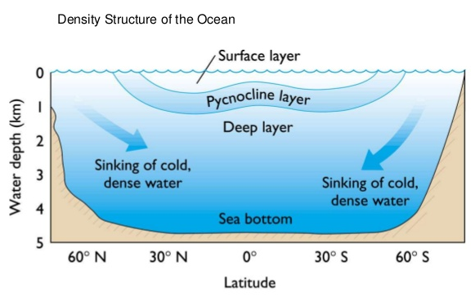
Ocean Density
Density refers to the amount of mass per unit volume, such as grams per cubic centimeter (g/cm³).
  The density of fresh water is 1 g/cm³ at 4ºC, but the addition of salts and other dissolved substances increases surface seawater density to between 1.02 and 1.03 g/cm³.
The density of seawater can be increased by reducing its temperature, increasing its salinity, or increasing the pressure.
  Cold, salty water is much denser than warm, fresher water and will sink below the less-dense layer.
  Varying densities can create deep ocean currents.

Slide 18
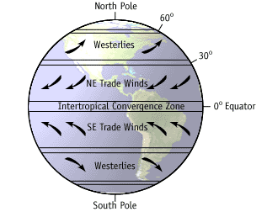
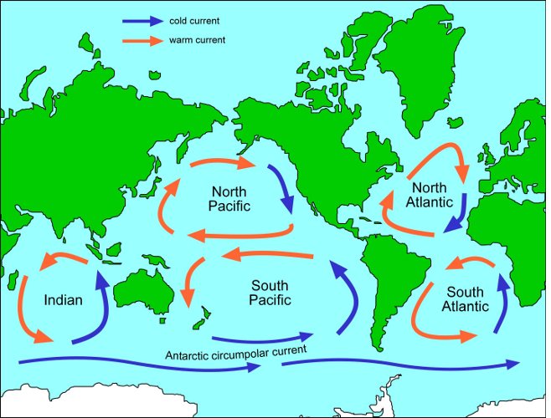
Ocean Circulation and Currents
Surface circulation is caused by the prevailing winds from atmospheric circulation (wind-driven).
Gyres are currents that form large, circular, closed clockwise cells centered about 30⁰ latitude from the prevailing winds.
  In the Southern Hemisphere, the patterns are the same, but the direction of the gyre is reversed.

Slide 19
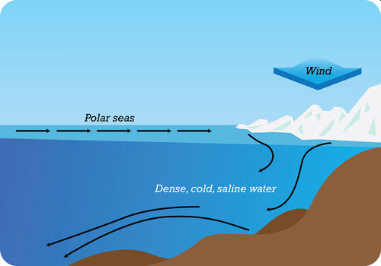
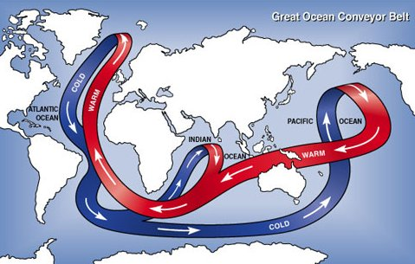
Ocean Circulation and Currents
Deep oceanic currents are caused by gravity in that denser waters sink.
In polar regions, due to increased salinity as ice forms and decreases in temperature due to a cold climate, the denser water sinks helping to drive the deep ocean currents.

Slide 20
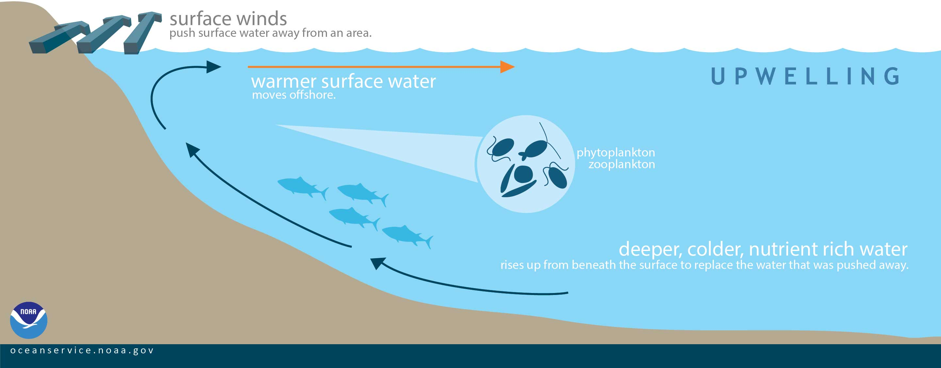
Ocean Circulation and Currents
Winds may generate deeper currents as well.
Deeper waters must come up as replacement in zones of upwelling caused by winds.
Upwelling refers to the welling-up of colder, deeper waters.
It encourages biological productivity by bringing nutrient-rich waters to the euphotic zone.

Slide 21
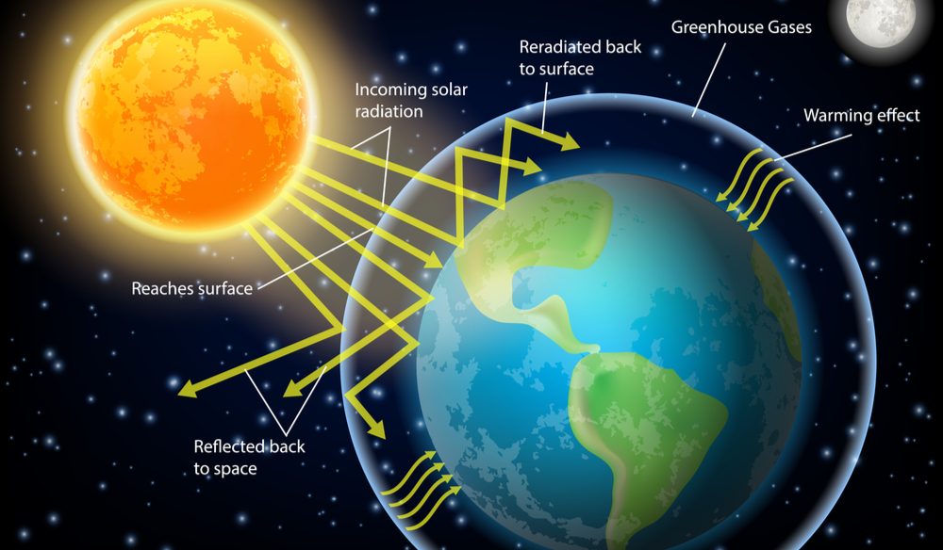
Effects of Oceans on Weather and Climate
The sun is Earth’s main source of energy.
The oceans, covering more than 70% of the planet’s surface absorb much of this energy.

Slide 22
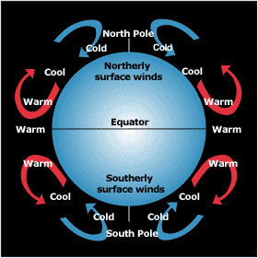
Effects of Oceans on Weather and Climate
As air warms, it rises. Then cold air flows to replace it.
More sunlight strikes the equator than the poles.
As hot air rises at the equator, colder air from the North and South poles rushes towards the equator to replace it.

Slide 23
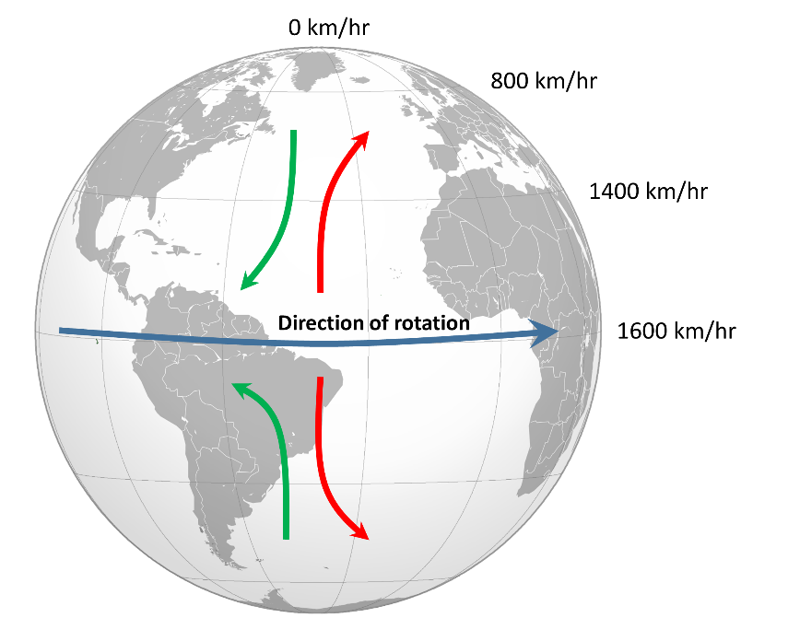
Effects of Oceans on Weather and Climate
Because the Earth rotates, air does not flow in a north-south direction, but is twisted.
This phenomenon is called the Coriolis effect.

Slide 24
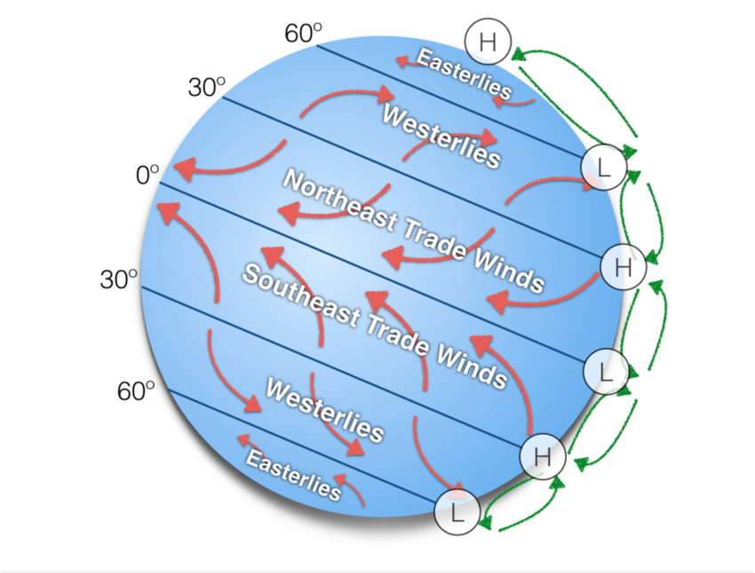
Effects of Oceans on Weather and Climate
Great wind circulation systems form.
Close to the equator, trade winds blow from the east.
In the temperate zone, steady winds called westerlies blow from the west.

Slide 25
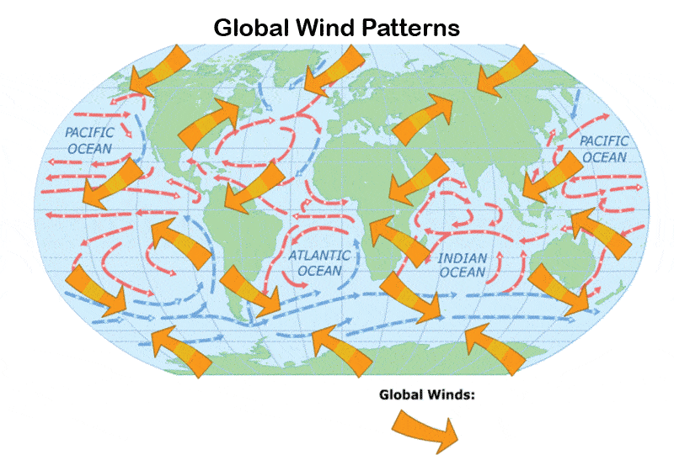
Effects of Oceans on Weather and Climate
Winds blowing across the ocean’s surface create currents.
The ocean’s currents closely match the prevailing winds.

Slide 26
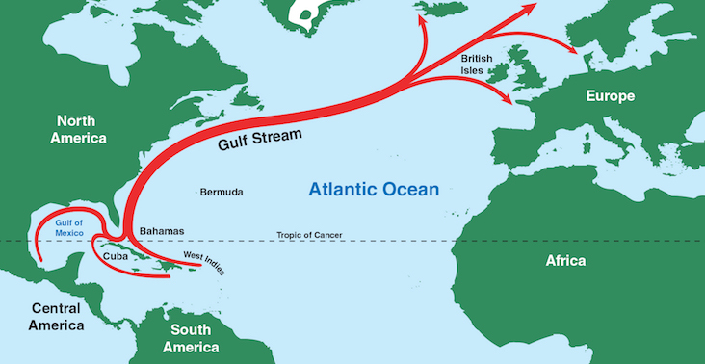
Effects of Oceans on Weather and Climate
Ocean currents affect the world’s climate by moving heat from the tropics toward the poles and cold from the poles towards the tropics.
The Gulf Stream carries warm waters towards Europe and as a result, London experiences much milder winters than New York City, even though London is much farther north.

Slide 27
Requirement 3
Describe the characteristics of ocean waves. Point out the differences among the storm surge, tsunami, tidal wave, and tidal bore. Explain the difference between sea, swell, and surf. Explain how breakers are formed.

Slide 28
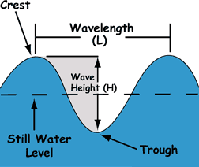
Characteristics of Waves
Wave crest is the highest point of a wave.
Wave trough is the lowest point of a wave.
Wave height is the vertical distance from the crest to the trough of a wave.
Wavelength is the distance measured from any point on one wave to the equivalent point on an adjacent wave.
Period is the time it takes for one wave to pass a specified point.

Slide 29
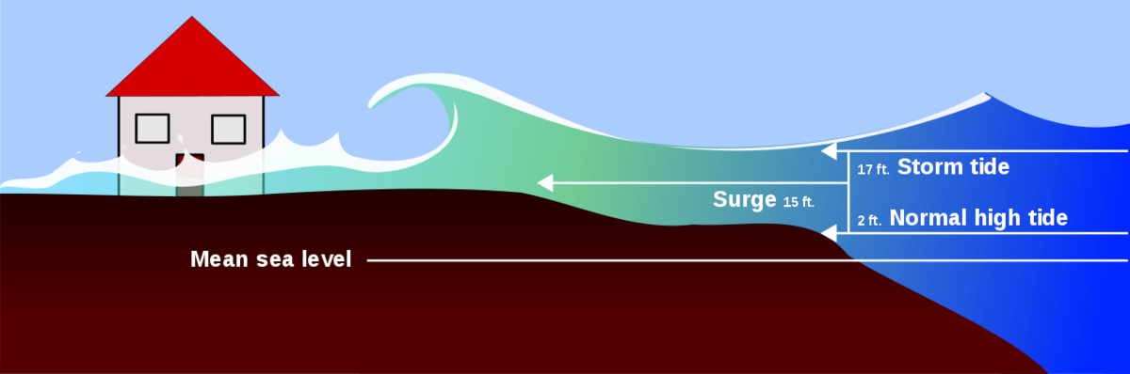
Storm Surge
The strong winds of a hurricane or storm push seawater toward the shore.
This advancing water may combine with normal tides to create a storm surge that can increase the tide level 15 feet or higher.
In addition, wind-driven waves rolling on top of the storm surge add to the destructive power.
Because so much of the U.S. population lives on the East and Gulf Coasts, many in locations just above sea level, the biggest danger from these storms is the storm surge.

Slide 30
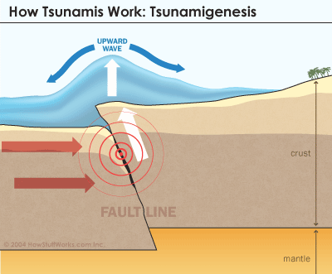
Tsunami
Tsunami is a Japanese word meaning "harbor wave."
Commonly called tidal waves but have nothing to do with the tide.
They are caused by some sudden movement of the earth’s crust that displaces water.
  Earthquakes, volcanic eruptions, or underwater landslides.
They may reach heights of 120 feet.
  The larger the underwater disturbance, the larger the tsunami.

Slide 31
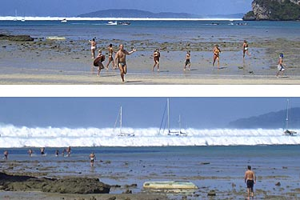
Tsunami Deception
Before the arrival of a tsunami, the water along the coast sometimes withdraws out to sea.
  Between waves, a harbor may seem to dry-up for a brief time.
  Tourists at Banda Aceh were attracted to the beach by receding water.
  Many were swept to their death by the fast moving waves that then came ashore.

Slide 32
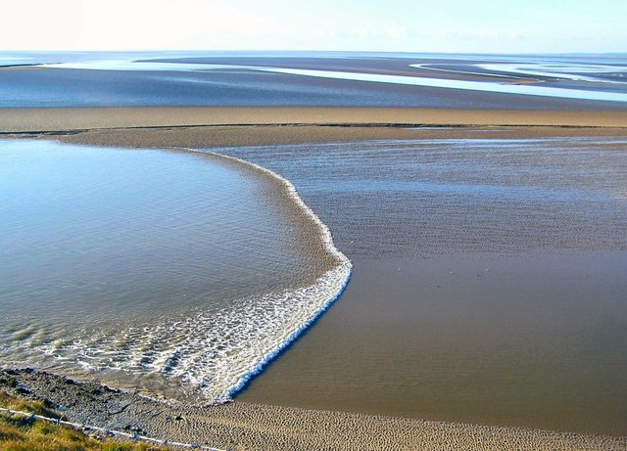
Tidal Bores
Tidal bores occur when the incoming tide forms a single wave that moves up a river or estuary as a foaming, churning wall of water.
Two conditions must exist for a bore to occur:
  The tidal range must be at least 6m (20 feet) high.
  The river basin must be long and funnel-shaped, its wide end facing the sea, and quite shallow, its depth regularly decreasing upstream.

Slide 33
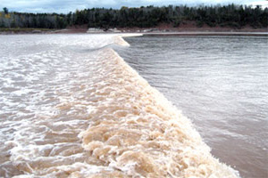
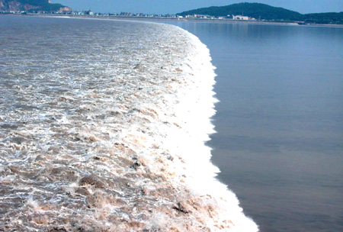
Prominent Tidal Bores
Bay of Fundy tidal bore in Nova Scotia – produces a wall of water up to 3.7m (12 feet) during spring tides.
Qiantang River tidal bore in China – may attain heights of 7.6m (25 feet) and moves at 12 to 13 knots.

Slide 34
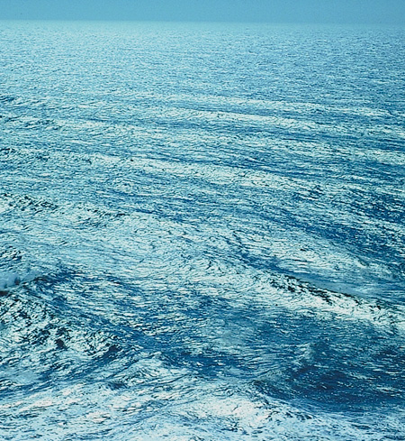
Swells, Breakers, and Surf
Swells are long, far-apart waves in the open ocean.

Slide 35
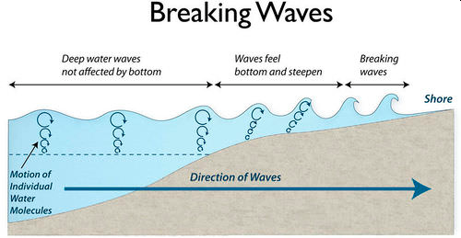
Swells, Breakers, and Surf
As swells approach shallow water, the ocean floor begins to affect the wave’s shape and speed.
Wave height increases and the crests become more peaked.
As the steepness of the wave increases, the forward speed of the crest becomes faster than the speed of the wave, and the wave breaks.

Slide 36
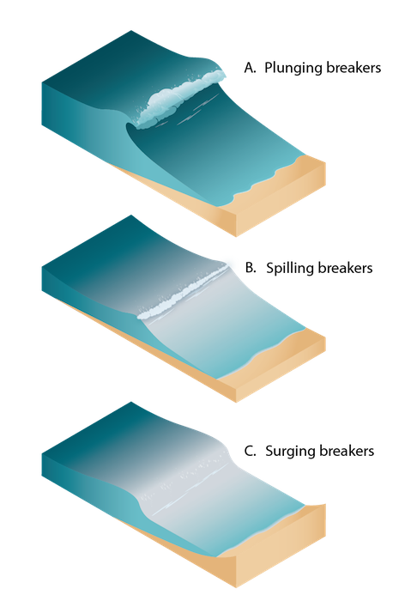
Swells, Breakers, and Surf
Waves that break into foam are called breakers.
Waves breaking on the shore are called surf.
Types of breakers include plunging, spilling, and surging.
  On less steep beaches, plunging breakers curl over in a tube shape and finally break on the beach.
  Gently sloping bottoms produce spillers that roll in evenly and slowly.
  Where the beach slope is steep, surging breakers roll in and hardly break at all.

Slide 37
Requirement 4
Draw a cross-section of underwater topography. Show what is meant by:
  Continental shelf
  Continental slope, and
  Abyssal plain

Slide 38
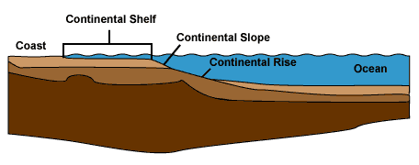
Continental Shelf, Slope, and Rise
A continental shelf is a portion of a continent that is submerged under an area of relatively shallow water known as a shelf sea.
The broad, gentle pitch of the continental shelf gives way to the relatively steep continental slope.
The more gradual transition to the abyssal plain is a sediment-filled region called the continental rise.
The continental shelf, slope, and rise are collectively called the continental margin.

Slide 39
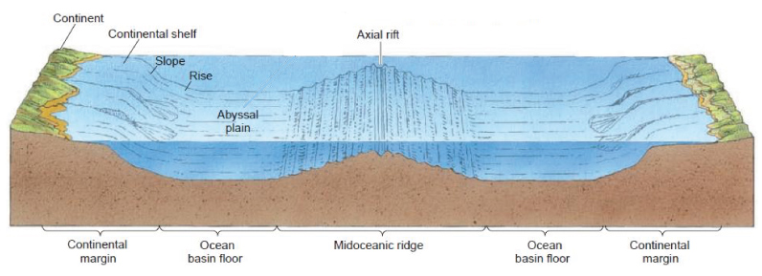
Abyssal Plain
Abyssal plains are sediment-covered portions of the deep ocean floor, usually found at depths between 3,000 meters and 6,000 meters (10000 to 20000 feet).
Lying generally between the foot of a continental rise and a mid-ocean ridge, abyssal plains cover more than 50% of the Earth's surface.

Slide 40
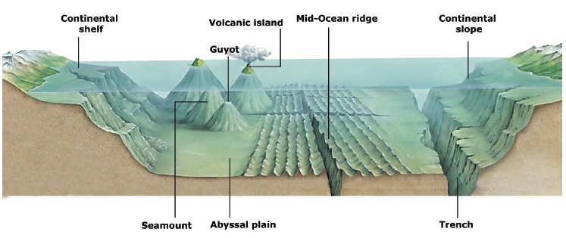
Requirement 5
Name and put on your drawing the following: seamount, guyot, rift valley, canyon, trench, and oceanic ridge. Compare the depths in the oceans with the heights of mountains on land.

Slide 41

Seamounts and Guyots
Seamounts and Guyots are volcanoes that have built up from the ocean floor, sometimes to sea level or above.
Guyots are seamounts that have built above sea level.
  Erosion by waves destroyed the top of the seamount resulting in a flattened shape.
  Due to the movement of the ocean floor away from oceanic ridges, the sea floor gradually sinks and the flattened guyots are submerged to become undersea flat-topped peaks.
  We know that the tops of guyots were once at the surface because they contain evidence of fossils such as coral reefs that only live in shallow water.
Seamounts conversely represent volcanoes that did not reach sea level so their tops remain intact and are shaped like volcanoes on land.

Slide 42
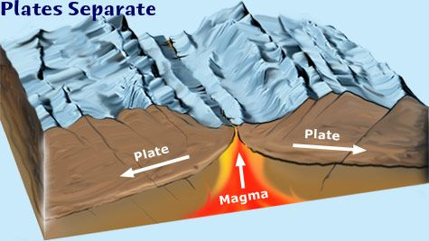
Rift Valley
A rift valley is a lowland region that forms where Earth’s tectonic plates move apart, or rift.
Rift valleys are found both on land and at the bottom of the ocean, where they are created by the process of seafloor spreading.
Rift valleys differ from river valleys and glacial valleys in that they are created by tectonic activity and not the process of erosion.

Slide 43
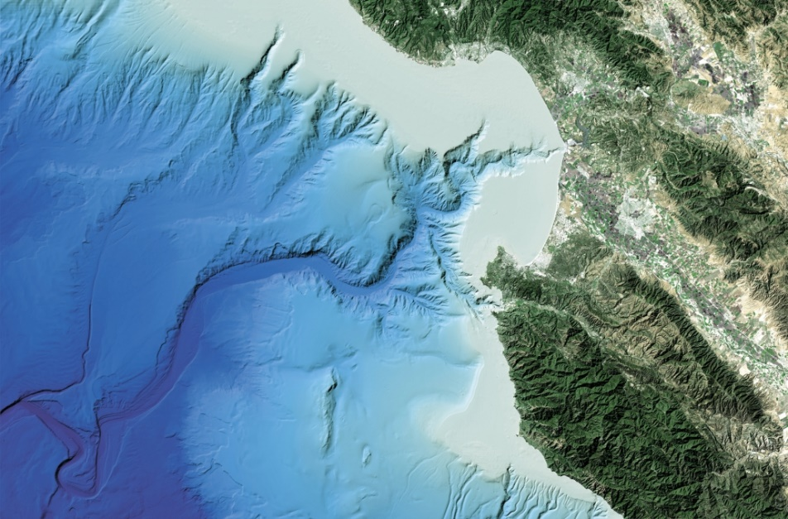
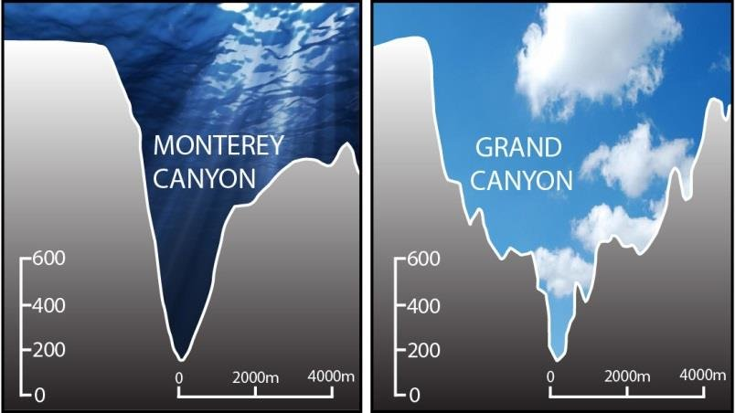
Submarine Canyons
Submarine canyons are steep-sided valleys cut into the seafloor of the continental slope, sometimes extending well onto the continental shelf.
Over geologic time, submarine canyons are formed by the repeated erosion of the slope by turbidity currents (dense mixtures of sand, mud, and other debris that move at high speeds down submarine canyons).
Monterey Canyon

Slide 44
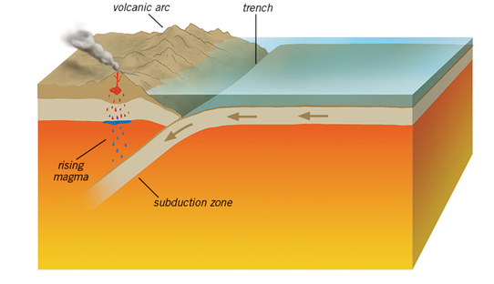
Trench
Ocean trenches are steep depressions in the deepest parts of the ocean where old ocean crust from one tectonic plate is pushed beneath another plate, raising mountains, causing earthquakes, and forming volcanoes on the seafloor and on land.

Slide 45
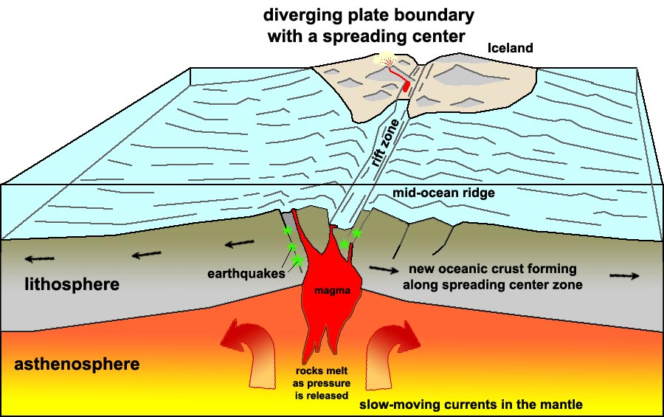
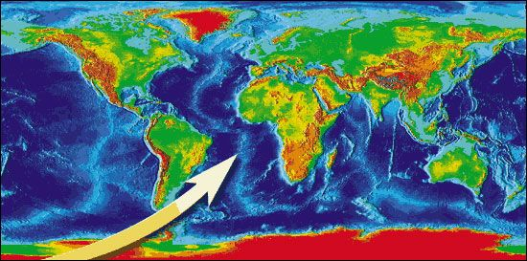
Oceanic Ridge
The mid-ocean ridge is a continuous range of undersea volcanic mountains that encircles the globe almost entirely underwater and is formed by plate tectonics.
At nearly 60,000 kilometers (37,000 miles) long, the mid-ocean ridge is the longest mountain range on Earth.
This feature is where seafloor spreading takes place along a divergent plate boundary.

Slide 46
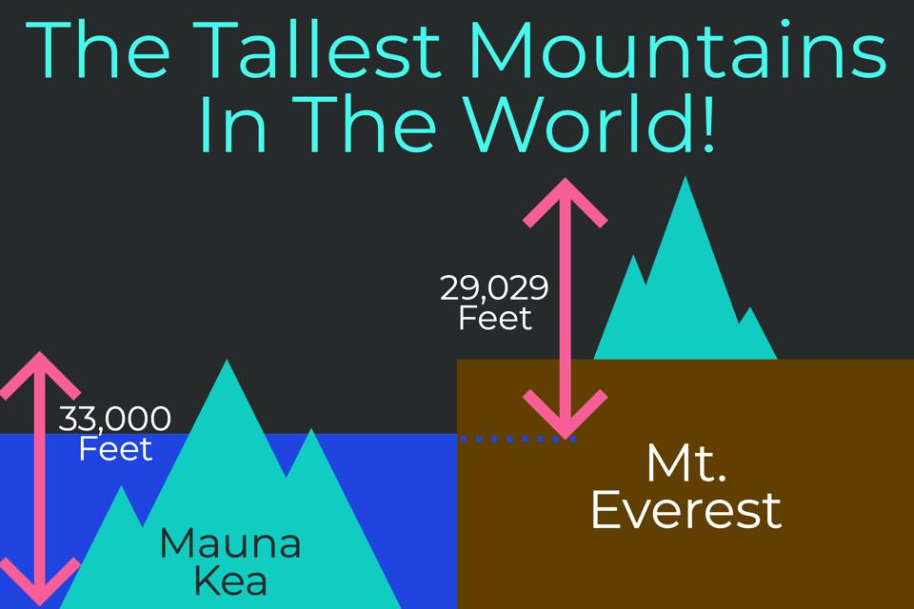
Mountain Heights, Ocean Depths
Highest Mountain on Land: Mt. Everest, Nepal – 29,029 Ft. (8,850M)
Highest Mountain on Earth: Mauna Kea, Hawaii – 33,476 Ft. (10,203M) from its base on the ocean floor.
  This mountain rises 13,796 Ft. (4,205M) above sea level, but almost 60 percent of its full height is below the surface.

Slide 47
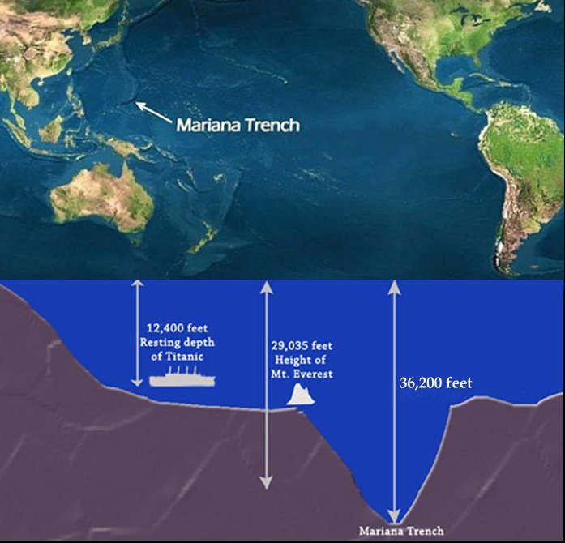
Mountain Heights, Ocean Depths
Greatest Ocean Depth: Challenger Deep, Mariana Trench – 36,200 Ft. (11,035M)

Slide 48
Requirement 6
List the main salts, gases, and nutrients in sea water. Describe some important properties of water. Tell how the animals and plants of the ocean affect the chemical composition of seawater. Explain how differences in evaporation and precipitation affect the salt content of the oceans.

Slide 49
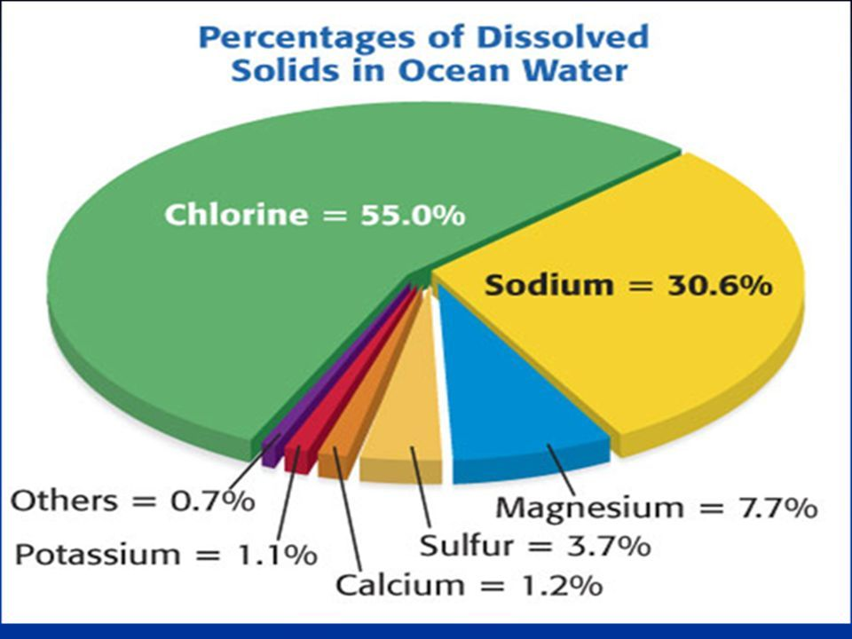
Salts
The salinity of seawater is usually 35 parts per thousand (also written as o/oo) in most marine areas.
This salinity measurement is a total of all the salts that are dissolved in the water.
The majority of the salt is the same as table salt (sodium chloride) but there are other salts as well.

Slide 50
Gases
Seawater has many different gases dissolved in it, especially nitrogen, oxygen and carbon dioxide.
It exchanges these gases with the atmosphere to keep a balance between the ocean and the atmosphere.
Dissolved Gases in the Ocean
Gas | Concentration in Seawater in Parts per Million
Nitrogen | 10-18 ppm
Oxygen | 0-13 ppm
Carbon Dioxide | 64-107 ppm

Slide 51
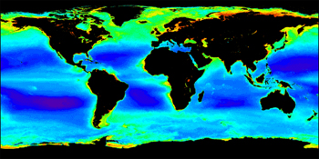
Nutrients
Fertilizers, like nitrogen (N), phosphorous (P), and potassium (K), are important for plant growth and are called 'nutrients.'
The level of dissolved nutrients increases from animal feces and decomposition (bacteria, fungi).
Surface water often may be lacking in nutrients because feces and dead matter tend to settle to the bottom of the ocean.
Most decomposition is thus at the bottom of the ocean which means that once surface nutrients get used up by the plants, they become a limiting factor for the growth of new plants.
Nutrients are returned to surface waters by a special type of current called 'upwelling' and it is in these areas of upwelling that we find the highest productivity of marine life.
Satellite map of chlorophyll concentration due to varying levels of dissolved nutrients.

Slide 52
Biologically Important Properties of Water
Properties | Comparison with Other Substances | Importance in Biological Processes
Boiling point | High (100⁰C) for molecular size | Causes most water to exist as a liquid at earth surface temperatures
Freezing point | High (0⁰C) for molecular size | Causes most water to exist as a liquid at earth surface temperatures
Surface tension | Highest of all liquids | Critical to position maintenance of sea surface organisms
Density of solid | Unique among common natural substances | Causes ice to float and inhibits complete freezing of large bodies of water
Latent heat of evaporation | Highest of all common natural substances (540cal/g) | Moderates sea-surface temperatures by transferring large quantities of heat to the atmosphere through evaporation
Latent heat of freezing | Highest of all common natural substances (80cal/g) | Inhibits large-scale freezing of oceans
Solvent power | Dissolves more substances in greater amounts than any other liquid | Maintains a large variety of substances in solution, enhancing a variety of chemical reactions
Heat capacity | High (1cal/g/⁰C) for molecular size | Moderate daily and seasonal temperature changes Stabilize body temperatures of organisms

Slide 53
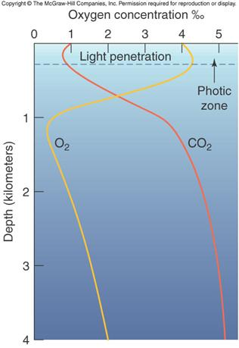
Biological Impacts
The amount of dissolved gases varies according to the types of life forms in the water.
Most living species need oxygen to keep their cells alive (both plants and animals) and are constantly using it up.
Replenishment of dissolved oxygen comes from the photosynthetic activity of plants (during daylight hours only) and from surface diffusion (to a lesser extent).
If there are a large number of plants in a marine water mass then the oxygen levels can be quite high during the day.
If there are few plants but a large number of animals in a marine water mass then the oxygen levels can be quite low.
Marine plants consume dissolved carbon dioxide for photosynthesis.

Slide 54


Ocean Salinity
Variations occur in ocean salinity due to several factors:
  If there is more evaporation than precipitation then the salinity increases (since salt is not evaporated into the atmosphere).
  If there is more precipitation (rain) than evaporation then the salinity decreases.
  Large rivers emptying into the ocean (like the Amazon River in South America) may make the ocean have little or no salt content for over a mile or more out to sea.
  The thawing of large icebergs (made of frozen fresh water and lacking any salt) will decrease the salinity while the actual freezing of seawater will increase the salinity temporarily.

Slide 55
Requirement 7
Describe some of the biologically important properties of seawater. Define benthos, nekton, and plankton. Name some of the plants and animals that make up each of these groups. Describe the place and importance of phytoplankton in the oceanic food chain.

Slide 56

Biological Properties of Seawater
Salinity:
  Many marine organisms are highly affected by changes in salinity.
  This is because of a process called osmosis which is the ability of water to move in and out of living cells, in response to a concentration of a dissolved material, until an equilibrium is reached.
Salinity map showing areas of high salinity (36 o/oo) in green, medium salinity in blue (35 o/oo), and low salinity (34 o/oo) in purple.

Slide 57


Biological Properties of Seawater
Salinity:
  Osmotic conformers have no mechanism to control osmosis and their cells are the same salt content as the liquid environment in which they are found.
  These marine osmotic conformers include the marine plants and invertebrate animals which do not do well in areas without a normal salinity of 35 o/oo.

Slide 58


Biological Properties of Seawater
Salinity:
  Osmotic regulators have a variety of mechanisms to control osmosis and the salt content of their cells varies.
  It does not matter what the salt content is of the water surrounding a marine osmotic regulator, their mechanisms will prevent any drastic changes to the living cells.
  Marine osmotic regulators include most of the fish, reptiles, birds and mammals.
  These are the organisms that are most likely to migrate long distances where they may encounter changes in salinity.

Slide 59

Biological Properties of Seawater
Temperature:
  Seawater temperature affects marine organisms by changing the reaction rates within their cell(s).
  Although each species has a specific range of temperature at which it can live, the warmer the water gets, the faster the reactions; and the cooler the water, the slower the reactions.
Seawater temperature map showing areas of warmer water in red and areas of cooler water is blue. White areas represent ice.

Slide 60


Biological Properties of Seawater
Dissolved Gases:
  The concentration of dissolved oxygen and carbon dioxide are very important for marine life forms.
  Dissolved oxygen is what animals with gills use for respiration (their gills extract the dissolved oxygen from the water flowing over the gill filaments).
  Dissolved carbon dioxide is what marine plants use for photosynthesis.

Slide 61

Biological Properties of Seawater
Nutrients:
  Fertilizers, like nitrogen (N), phosphorous (P), and potassium (K), are important for plant growth and are called 'nutrients.'
  The level of dissolved nutrients increases from animal feces and decomposition (bacteria, fungi).
  Surface water, often may be lacking in nutrients because feces and dead matter tend to settle to the bottom of the ocean.
  Once surface nutrients get used up by the plants, they become a limiting factor for the growth of new plants.
  Nutrients are returned to surface waters by a special type of current called 'upwelling' and it is in these areas of upwelling that we find the highest productivity of marine life.

Slide 62

Biological Properties of Seawater
pH is a measure of the acidity or alkalinity of a substance and is one of the stable measurements in seawater.
Ocean water has an excellent buffering system with the interaction of carbon dioxide and water so that it is generally always at a pH of 7.5 to 8.5.
Because of human-driven increased levels of carbon dioxide in the atmosphere, there is more CO₂ dissolving into the ocean overwhelming the buffer system.
As the ocean continues to absorb more CO₂, the pH decreases and the ocean becomes more acidic.
The rising acidity of the oceans threatens coral reefs by making it harder for corals to build their skeletons.

Slide 63

Plankton, Nekton, and Benthos
Plankton are marine drifters — organisms carried along by tides and currents.
  The most basic categories divide plankton into two groups: phytoplankton (plants) and zooplankton (animals).
Nekton are the aquatic animals that are able to swim and move independently of water currents.
  Examples include whales, fish, and squid.
Benthos is the flora and fauna found on the bottom, or in the bottom sediments, of a sea, lake, or other body of water.
  Clams, worms, oysters, shrimp-like crustaceans and mussels are all examples of benthic organisms.

Slide 64

Ocean Food Chain
In the sea, the plankton begin the marine food chain.
Microscopic phytoplankton (tiny plant-like cells) use the sun’s energy to combine carbon dioxide and water to create sugar and oxygen in the process known as photosynthesis.
They account for about 50% of all photosynthesis on Earth.
The phytoplankton are the food of herbivorous zooplankton (animal plankton) in turn eaten by carnivorous zooplankton.
Together all the plankton are the food for fish, which in turn are eaten by other sea creatures such as seabirds, sharks, and seals, in their turn eaten by larger predators like killer-whales.
The plankton are also the food source of some of the largest mammals on Earth, the baleen whales.

Slide 65
Requirement 8
Do ONE of the following:
  Make a plankton net. Tow the net by a dock, wade with it, hold it in a current, or tow it from a rowboat. Do this for about 20 minutes. Save the sample. Examine it under a microscope or high-power glass. Identify the three most common types of plankton in the sample.

Slide 66

Plankton Net
Materials:
One two‐liter soda bottle with cap
One Nylon knee high stocking
Nylon or other heavy‐duty string (about 9 feet)
Duct Tape
Scissors
Hole Puncher
Small Collection jar (baby food jars are fine)

Slide 67

Plankton Net
Materials:
One two‐liter soda bottle with cap
One Nylon knee high stocking
Nylon or other heavy‐duty string (about 9 feet)
Duct Tape
Scissors
Hole Puncher
Small Collection jar (baby food jars are fine)
Directions:
Remove cap from soda bottle and set aside and flatten out soda bottle as much as possible.
Cut the soda bottle at 2 places to have 3 separate parts. (see figure 1)
  The first cut should be made about 3 inches down from the neck of the bottle.
  The second should be made about 4 inches down from the first cut.
  Recycle the bottom part of the bottle.
Cut small hole at toe of nylon stocking.

Slide 68

Plankton Net
Slide top portion of bottle through stocking so neck of bottle is sticking through hole in toe. Pull till snug then tape in place. Attach middle of bottle to other end of stocking. (see figure 2)
Punch 3 holes evenly spaced apart around the open end (the end not attached to the nylon stocking) of the middle portion of the soda bottle. (see figure 2)
Cut string into 3 three‐foot pieces; attach each string to a hole.
Tie the 3 pieces of string together at the end to make a tow line. (see figure 2)
Replace cap onto neck of your new plankton net.

Slide 69

Plankton Net
Wade through water with open end of the plankton net moving through the surface water, be careful NOT to drag on the bottom of the seafloor and fill with sand. Plankton will collect on the nylon stocking of your plankton net; squeeze down while in the water to collect into capped neck of the bottle.
Remove cap to pour collected sample into collection jar.
Since plankton are microscopic, you likely won’t be able to check out their details, like antennae or body shape, without the aid of a microscope. But you probably will find some other microorganisms within your net that you will be able to see easily without a microscope. Use a magnifying glass or your cellphone camera to check out what you’ve found.

Slide 70
Requirement 8
Do ONE of the following:
  Make a series of models (clay or plaster and wood) of a volcanic island. Show the growth of an atoll from a fringing reef through a barrier reef. Describe the Darwinian theory of coral reef formation.

Slide 71

Reef Formation
Darwin noticed that both fringing and barrier reefs tended to surround volcanic islands, and he reasoned reefs initially formed on the fringe of volcanic islands.
When the volcano died and slowly sank back into the ocean, the coral reef remained and growth kept pace with the change in relative sea level, first becoming a separated barrier reef and eventually, after the volcano sank entirely, an atoll.

Slide 72
Requirement 8
Do ONE of the following:
  Measure the water temperature at the surface, midwater, and bottom of a body of water four times daily for five consecutive days. You may measure depth with a rock tied to a line. Make a Secchi disk to measure turbidity (how much suspended sedimentation is in the water). Measure the air temperature. Note the cloud cover and roughness of the water. Show your findings (air and water temperature, turbidity) on a graph. Tell how the water temperature changes with air temperature.

Slide 73

Oceanographic Log Sheet
Download and print out the Oceanographic Log Sheet and graph paper.

Slide 74

Measure Water Depth
Materials Needed:
  Nylon line
  Rock or weight
  Indelible pen or clothespin
  Tape measure
To find the depth of the water, tie a rock or weight to a nylon line and drop it in.
When the rock or weight touches the bottom, mark the line with an indelible pen (or pin a clothespin to it) at the surface.
Pull up the rock or weight and measure the depth from the rock to the mark.
You can now determine where to take the different water temperature measurements.

Slide 75

Measuring Water Temperature
Materials Needed:
  Thermometer
  Nylon line
  Weight
Use a thermometer to measure the surface water temperature of the pond.
The water temperature at midwater and the deepest part of a body of water can be measured using a thermometer attached to a weighted rope.
Lower the device to the correct depth and leave it suspended there for approximately 5 minutes.
Raise the thermometer quickly through the water column, and check the temperature immediately.
Thermometers can be purchased from local hardware stores, aquarium shops, or various equipment supply companies.

Slide 76
How to Make a Secchi Disc
Materials Needed:
20 cm diameter circle of acrylic disk 3/8” or 1/2” in thickness (aluminum or steel may be substituted, but wood is not recommended)
15 cm circle or square of 1/8” galvanized steel (used to weight the disk)
Hand drill
Eye bolt – 5/16” x 2”
Two flat 5/16” washers
One locking 5/16” washer
Two 5/16” nuts
Flat black rust resistant spray paint
Flat white rust resistant spray paint
Masking tape
Nylon rope (cut long enough to be the depth of your lake deep spot.
Avoid cotton rope because it stretches)

Slide 77

How to Make a Secchi Disc
Instructions:
Divide the 20 cm acrylic disk into quadrants using masking tape. Spray paint alternating quadrants black and white, so that you have a disk that is similar to that pictured. Let the paint dry. Apply a second coat of paint if necessary.
Drill a hole of 3/8’ through the center of the acrylic disk and the galvanized steel disk.
Assemble disks with eyebolt (5/16” in diameter). Use flat washers between disk and nut, and between steel plate and locking washer. Use 5/16” nuts at the top of the eyebolt and to bolt the steel plate on the underside of the acrylic disk.
Attach a rope calibrated by 0.5 meter increments to the Secchi-disk to use in the lake.
Note: Avoid using cotton rope or clothesline since it stretches when it is wet. Calibrate the rope at 0.5 meter increments using permanent pen, or by tying knots at each 0.5 meter interval.

Slide 78


Secchi Disc
Be careful not to disturb the water as that will interfere with the reading.
Do not wear sunglasses.
Lower the Secchi disk on the sunny side of the boat or dock. Drop the disk straight down just until it disappears. Mark the rope at the waterline with a clothespin. Slowly pull the rope up until the disk reappears. Mark the rope at the waterline with another clothespin.
Determine the midpoint between the clothespins. Measure from that point to the Secchi disk to find how deep you can see into the water. Record that information to the nearest inch on your log sheet.

Slide 79

Turbidity
Turbidity is the result of suspended solids in the water that reduce the transmission of light and is measured with a Secchi disk.
Sources of turbidity:
  Soil erosion
  Urban runoff
  Abundant bottom feeders (carp) that stir up bottom sediments
  Presence of excess nutrients that result in algal growth.

Slide 80
Requirement 8
Do ONE of the following:
  Make a model showing the inshore sediment movement by littoral currents, tidal movement, and wave action. Include such formations as high and low waterlines, low tide terrace, berm, and coastal cliffs. Show how the offshore bars are built up and torn down.

Slide 81

Littoral Currents
Longshore drift from longshore (littoral) current is a geological process that consists of the transportation of sediments (clay, silt, pebbles, sand,) along a coast parallel to the shoreline.
Waves coming in at an angle generate a water current which moves parallel to the coast.
Longshore drift is simply the sediment moved by the longshore current.
This current and sediment movement occur within the surf zone.
The strength of the longshore current increases as the size of the waves and the approach angle increase.
When the longshore current grows strong enough to overcome the force of incoming waves, the water will flow seaward in a riptide, or rip current.

Slide 82


Rip Currents
Rip currents are water movements away from the shore that occur whenever currents funnel through a narrow opening formed by the erosion of a channel.
They are localized and their position changes with changes in wave conditions.
The higher the waves the stronger the rip current.

Slide 83

Rip Currents
If you are ever caught in a rip current, try to swim parallel to the beach rather than against the current.
A rip current is narrow and you soon will be out of it.
Rip currents are also referred to as “undertow.”
There is no real undertow that draws or sucks swimmers under.

Slide 84

Tidal Currents
The role of tides in molding coastal landforms is twofold:
  Tidal currents transport large quantities of sediment and may erode bedrock.
  The rise and fall of the tide distributes wave energy across a shore zone by changing the depth of water and the position of the shoreline.
Tidal currents transport sediment in the same way that longshore currents do.
  The speeds necessary to transport the sediment (typically sand) are generated only under certain conditions—usually in inlets, at the mouths of estuaries, or any other place where there is a constriction in the coast through which tidal exchange must take place.
  Tidal currents on the open coast, such as along a beach or rocky coast, are not swift enough to transport sediment.

Slide 85

Beach Anatomy
A beach is made up of sand and sediment along a coast.
  It contains the shore, nearshore, and offshore.
  Shore: is from the seaward lowest tide to the highest point of waves influence on land.
      Backshore: is only submerged during the highest tides and during strong storms.
      Foreshore: extends to the low tide shoreline.
  Nearshore: is from the low-tide shoreline to the low-tide breaker line.
  Offshore: is to the low tide limit of waves reworking the sediments.

Slide 86

Beach Anatomy (continued)
  Wave-cut terraces: flat beveled bedrock formed by waves and moving sediments
  Troughs and bars: parallel the shore.
  Berms: where foreshore/backshore meet.
    Formed by shoreward deposition.
    Have higher elevation or slope.
    Have flat top, maybe ridge or berm crest.

Slide 87

Offshore Bars
Most beaches go through a seasonal cycle because conditions change from summer to winter.
In summer, sea conditions are relatively calm, while winter conditions are rougher.
The heavy seas of winter gradually erode sand from beaches, moving it to an underwater sandbar offshore from the beach.
The gentler waves of summer gradually push this sand back toward the shore, creating a wider and flatter beach.

Slide 88
Requirement 8
Do ONE of the following:
  Make a wave generator. Show reflection and refraction of waves. Show how groins, jetties, and breakwaters affect these patterns.

Slide 89

Wave Generator
Download and print out the Wave Generator document to create a wave generator for demonstrating wave reflection, wave refraction, and the effects of jetties, groins, and breakwaters.

Slide 90

Wave Reflection
Reflection is the return of a wave seaward when the wave strikes on a very step beach, barrier, or other nearly vertical surface.
The original waves and the reflected waves may interfere with each other and cancel out or they may reinforce each other.

Slide 91


Wave Refraction
Refraction occurs when deep-water waves entering a shallow region at an angle are bent as they touch bottom.
The part of the crest entering shallow water first moves more slowly than the part of the wave still in deep water.
The wave front bends to fit the shore.

Slide 92

Jetties, Groins, and Breakwaters
Groins are shore perpendicular structures, used to maintain beaches by trapping sand moving in the longshore transport system.
Jetties are another type of shore perpendicular structure and are placed adjacent to harbors to keep a navigation inlet free from sand accumulation.
A breakwater is a man-made structure built out into the sea with the purpose of creating a safe harbor, marina or anchorage for fishing vessels, and protecting the coast from powerful swells and waves.

Slide 93

Requirement 8
Do ONE of the following:
  Track and monitor satellite images available on the Internet for a specific location for three weeks. Describe what you have learned to your counselor.

Slide 94

Satellite Monitoring
Monitor Sea Surface Temperature (SST)
Monitor Weather

Slide 95


Requirement 9
Do ONE of the following:
  Write a 500-word report on a book about oceanography approved by your counselor.

Slide 96
Requirement 9
Do ONE of the following:
  Visit one of the following: (1) an oceanographic research ship, or (2) an oceanographic institute, marine laboratory, or marine aquarium. Write a 500-word report about your visit.

Slide 97

Oceanographic Research Vessel
The U.S. Environmental Protection Agency conducts tours of its largest research vessel, the Lake Guardian, for the public while the ship is docked.
This ship conducts research on all five Great Lakes.

Slide 98


Oceanographic Institute
Woods Hole Oceanographic Institute 93 Water St., Falmouth, MA 02543 (508) 289-2252 or information@whoi.edu
Scripps Institution of Oceanography
9500 Gilman Drive
La Jolla, CA 92093
(858) 246-5511

Slide 99


Marine Laboratory
Bowling Green State University Marine Laboratory

Slide 100

Marine Aquarium
Toledo Zoo Aquarium

Slide 101
Requirement 9
Do ONE of the following:
  Explain to your troop in a five minute prepared speech "Why Oceanography Is Important" or describe "Career Opportunities in Oceanography." (Before making your speech, show your speech outline to your counselor for approval.)

Slide 102

Importance of Oceanography

Slide 103

Careers in Oceanography
Most jobs in the field require at least a bachelor's degree in oceanography or in a related field such as biology, chemistry, physics or geology. Some positions may require a master's degree or a Ph.D.
The job outlook as a whole are good, with an expected growth of 14 percent in the years from 2016 to 2026.

Slide 104

Careers in Oceanography
Plenty of ocean-related career opportunities exist, including:
Aquaculture
Fish and Game Officer
Ocean Engineering
Marine Biologist
Marine Mammal Trainer
Marine Archeology
Marine Researcher
Marine Environment Educator/ Oceanography
Aquatic Veterinarian
Scuba Diving Instructor and Underwater Filmmaker
Marine Scientist
Marine Environment Economist
Underwater Photographer

Slide 105
Requirement 10
Describe four methods that marine scientists use to investigate the ocean, underlying geology, and organisms living in the water.

Slide 106

Oceanographic Study Techniques
Oceanographic Research Vessels carry out research on the physical, chemical, and biological characteristics of water, the atmosphere, and climate, and to these ends carry equipment for collecting water samples from a range of depths, including the deep seas, as well as equipment for the hydrographic sounding of the seabed, along with numerous other environmental sensors.
These vessels often also carry scientific divers and unmanned underwater vehicles.

Slide 107


Oceanographic Study Techniques
Drilling Into the Ocean Sediments and taking sediment and core samples.
Analysis of these samples help scientists understand changes in ocean temperature, sea ice extent, and primary productivity throughout the last several thousands of years.

Slide 108


Oceanographic Study Techniques
Autonomous Sensing Devices to record data over time or in difficult locations.
Some float while others are anchored.
Often used as survey platforms to map the seafloor or characterize physical, chemical, or biological properties of the water.

Slide 109

Oceanographic Study Techniques
Remote Sensing/Satellites.
The main applications are ocean weather and climate studies, measuring primary productivity, water quality monitoring, detection of potential fishing zone, marine life assessment, marine pollution monitoring, determination of near shore bathymetry and mapping, sensing of ocean currents and waves, human impacts on marine and coastal life etc.

